Slide 1
Jane Addams Book Award
Notes:
The Jane Addams book awards are given annually to children’s books promoting the causes of peace, social justice, world community, and the equality of the sexes and races. There are two winners each year - one for older children and one for younger children.

Slide 2
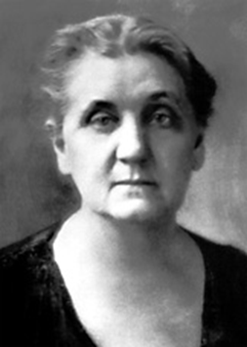
Jane Addams
Founded Hull House
“Mother“ of modern social work
Was the first American woman to win the Nobel Peace Prize in 1931
Image: nobelprize.org
Notes:
Jane Addams is the inspiration for the awards. If you are not familiar with her, she is known as the mother of modern social work due to her efforts at Hull House in Chicago at the turn of the 20th century. Hull House opened in 1889 to serve recent immigrants with health care services and education. It became known as a place where women could get help and education, and many women who received services at Hull House later became influential reformers in social work. For her life’s work, she earned the Nobel peace prize, and was the first American woman to do so.

Slide 3
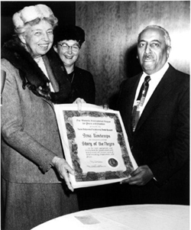
History of the Award
Presented annually since 1953
Given by The Jane Addams Peace Association and Women's International League for Peace and Freedom
A Picture Book category was created in 1993
Notes:
The Jane Addams book awards have been given annually since 1953 by the Jane Addams Peace association and the Women’s International League for peace and freedom. Both associations have similar visions. The picture shows Eleanor Roosevelt and JACBA founder Marta Teele presenting Arna Bontemps with the 1956 Award for his book The Story of the Negro.

Slide 4
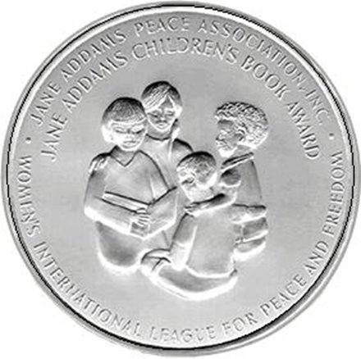
Significance of the Award
To promote the cause of peace, social justice, world community, and equality of the sexes and all races.
Winners are chosen by a 10 member committee made up of WILPF members.
Image: home.igp.org
Notes:
The significance of the award lies in the themes of the winning books. They promote social justice, equality and diversity. Interestingly enough, the winners are not selected by experts on children’s literature, but by a panel mostly made up of members of the women’s international league for peace and freedom. 6-7 out of 10 of the people on the committee are WILPF members. The committee members are appointed annually by the chairperson of the book selection committee.

Slide 5
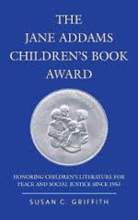
Winning an Award
Two annual winners
younger and older children
Winners receive $1000 and a certificate
Honor Selections (usually two)
Image: janeaddamspeace.org
Notes:
Two winners are selected each year – one for older and one for younger children. Winners receive $1000. There are usually two honor winners, but occasionally more or less. Honor winners receive a lesser cash award.

Slide 6
Selection Criteria
Promotes peace, social justice, equality, and world community
Fiction, poetry, or nonfiction of any length
Suitable for ages two through twelve
Well-written and illustrated, though illustrations are not required
Published in the United States

Slide 7
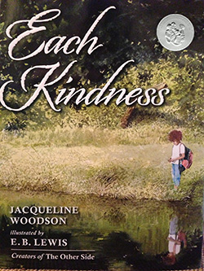
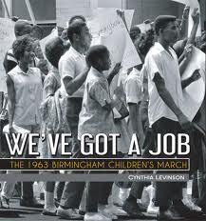
2013 Winners
Each Kindness by Jaqueline Woodson
We’ve Got a Job by Cynthia Levinson
Image: amazon.com
Notes:
In 2013, 3 of the 6 winners focused on the Civil Rights movement including We’ve Got a Job which won for older children and both of the honor books – We March and Marching to the Mountaintop. Each Kindness was the winner for younger children.

Slide 8
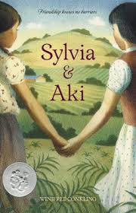
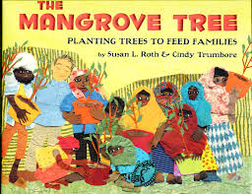
2012 Winners
The Mangrove Tree: Planting Trees to Feed Families by Susan L. Roth & Cindy Trumbore, illustrated by Susan L. Roth
Sylvia & Aki by Winifred Conkling
Image: spigotsscience.com
Image: janeaddamspeace.org
Notes:
The 2012 winner for younger children was The Mangrove Tree which is the story of how an African village finds a way out of poverty by planting and harvesting mangrove trees. Sylvia and Aki was the 2012 winner for older students.

Slide 9
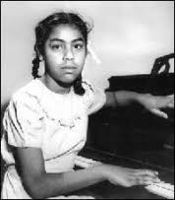
The Story of Sylvia Mendez
Image: winstamps.post
Mendez v. Westminster
Sylvia Mendez was awarded the Presidential Medal of Freedom in 2011
How can you use this book?
Discuss social injustice of segregation
Predecessor to Brown v. Board of Education
Discuss Japanese Internment Camps
Chapter Headings - how they reveal the story
“One kind word can warm three winter nights.”
Image: sylviamendezinthemendezvswestminster.com
Notes:
Sylvia and Aki tells the story of Sylvia Mendez. It is typical of the type of story celebrated by the Jane Addams book awards. Though Sylvia and Aki has been fictionalized, it was inspired by real events in Sylvia Mendez’s life. Sylvia’s family moves onto a California farm vacated by Aki’s family because they have been sent to a Japanese internment camp. Sylvia’s family is excited to be moving into the prestigious Westminster school district, but they are told that because Sylvia is Mexican, she must attend another school. Sylvia’s father filed a lawsuit which he eventually won – Mendez v. Westminster. This lawsuit set the stage for Brown v. the Board of Education
Sylvia Mendez won the Presidential Medal for Politics and Government in 2011. Listed are some ideas for fostering discussion about the themes in Sylvia and Aki. Jane Addams book award winners are usually rich in discussion possibilities. The themes of social justice, equality, and diversity found in Jane Addams award winners make them important books for any elementary or middle school library.

Slide 10
Bibliography
Jane Addams Peace Association. (2014). Retrieved April 6, 2014, from Jane Addams Children's Books Awards: http://www.janeaddamspeace.org/jacba/
Nobel Media. (2013). Jane Addams - Biographical. Retrieved April 6, 2014, from Nobel Prize Web site: http://www.nobelprize.org/nobel_prizes/peace/laureat es/1931/addams-bio.html
WILPF. (2013). Retrieved April 6, 2014, from Women's International League for Peace and Freedom: http://wilpfus.org/

